Slide 1
Research Skills
Prediction of crime rate in urban neighborhoods based on machine learning
Engineering Applications of Artificial Intelligence
Volume 106, November 2021, 104460
Authors: Jingyi He, Hao Zheng
Citations: 1

Slide 2
Introduction
Short description of the field
Research background
Problem statement
Technical discussions
Objectives

Slide 3
Short description of the field
As the impact of crime on the lives of residents has increased, there are a number of methods for predicting where crime will occur.
This paper uses GAN neural networks to build a prediction model of city floor plans and corresponding crime distribution maps.
Philadelphia, 2006-2018 data.
Two thousand sets of one-to-one corresponding images as the training set.
In addition, the ideas in this paper can be applied as a set of methodologies to predict other relevant urban characteristic parameters and visualize them.

Slide 4
Research background
Effects of crime – quality of life, social problems, public and private sectors, choosing areas to relocate and visit, etc;
Affects of crime – politics, economics, culture and education, employment, legal concepts, work problems, etc;
Plain methods such as more disaggregated panel date approaches, natural experiments, international data, and individual-level analysis were used to explore the association between unemployment and the occurrence of crime events;
Some traditional machine learning-based methods used before – multiple regression and careful selection, cab traffic;

Slide 5
Research background
A spatial auto-regression was proposed to automatically predict urban high-risk crime areas and crime trends.
Crime data of Chicago for the period 2014-2016
8.7-11.9% MAPE (Mean Absolute Percentage Error)
5 different machine learning algorithms
Type of crimes, specific times and places
Decision tree model – accuracy of 99.88%
Crime events analyzed in YD
Period: 2012-2015
Prediction models: Bayesian networks, random trees, and neural networks
Random trees – accuracy of 97.4%

Slide 6
Problem statement
Problems with traditional approach
good for prediction on long time
not suitable predictor when considered on monthly basis (doesn’t consider environmental factors)
Multiple regression
Rely on historical crime data
Problems in crime incidence prediction
Difficulties in detecting nonlinear relationships, redundancy and dependencies between multiple data sets
RNN (Recurrent) and CNN(Convolutional)
for the aid given to the designer, the architect is concerned with the environmental security as the security in the planning area over a long period of time rather than the crime rate at a specific time in the future;

Slide 7
Objectives
Generative model for predicting the city’s crime hotspot map
Stylize a city map of Philadelphia
Collect latitude and longitude data of crime (from the government)
Combine big data of crime information with the city map
Train and generate a GAN model
Both general users and planners can visualize and predict the crime rate by computer
Use crime heat map for city planning and building
Use neural-network model to determine that this map effected to reduce the crime rate or not
This study focuses more on the crime situation in pre-designed areas to provide suggestions to improve the design.

Slide 8
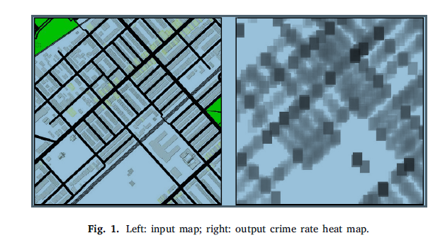
Objectives

Slide 9
Methodology (Scope of the work)
Generative adversarial network
The generation of crime heat map
The collection of city maps
Neural network trainings

Slide 10
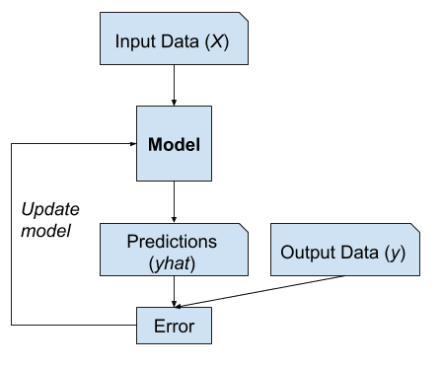
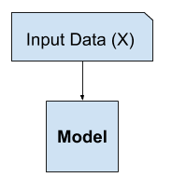
Supervised and unsupervised learning
Supervised learning
Unsupervised learning

Slide 11
Generative adversarial network
Consists of two neural networks which are rained alternately and compete with each other
The first one is a generator (G) which mimics the real data distribution as much as possible to generate fake training sample P data
The other neural network is the discriminator(D) which attempts to correctly determine whether the input data comes from real data or data created by the generator
Goal is Nash Equilibrium - game concept that determines the optimal solution in a non-cooperative game in which each player lacks any incentive to change his/her initial strategy.

Slide 12
Generative adversarial network
During the training, the real data X and the generated data G(Z) are input into the discriminator simultaneously
The discriminator outputs probability values that rate the authenticity of the two sets of data.
The discriminator minimizes the cross-entropy of the actual output result and the expected output result while the generator maximizes the probability that the generated data is true by adjusting the parameters based on the feedback from the discriminator. (it improves accuracy of the generator and the discriminator)
Training is optimal when D(X) and D(G(Z)) are equal.

Slide 13
Generative adversarial network
GAN is a neural network based on inputting graphics and outputting images.
Each map may contain hundreds of data points on criminal activity and outputting a large number of coordinates is unintuitive.
the GAN takes city maps as input and crime-rate heat maps as output and trains the network to recognize the relationship between two sets of images.
The trained network model can give a crime-rate prediction based on a given map of the city area.

Slide 14
The generation of crime heat map
Creating an empty matrix M with the size ox 10000pixels * 10000 pixels.
Latitude and longitude are converted into coordinates by integers of 0 to 10000)
NumPy package is using to convert the two-dimensional array to a three-dimensional array.
Calculation of points with 17x17 range on the map
when it is less that 17 pixels, the recognition of the heat map by the neural network is insufficient;
when the square is larger than 17 pixels an overflow occurs during ordinary computer operations.

Slide 15
The generation of crime heat map
Using the loop command to mark each point in the matrix M with the size of 10000 ∗ 10000, and for each marked point, we add 1 to the number corresponding to the matrix. (each loop marks 289 points)
Each number of the matrix M after the loop represents the number of times it is marked. (drawing more marked points with the color of grey)
Presenting the color of grey, it is possible to output a crime heat map with a resolution of 6000dpi.
Unmarked points appear white, while the points marked the most times appear black.

Slide 16
The generation of crime heat map
Other functions which have been tried:
Seaborn function
based on the principle of drawing a histogram and directly depicts the position of the point
the performance in the areas with lower crime rates is not ideal and the overall color was very light
The Hist function
histogram as the basic principle of operation
assessing the density of the points around the center to determine the point’s color depth
Better than Seaborn
no parameter to control the range of the reference points to determine the color of a certain point
Sklearn_kde and Gaussian-kde
all scatter plots considered to product the density value of each point in heat map
the colors of several blocks are similar (better for crime-prone areas for overall map)

Slide 17
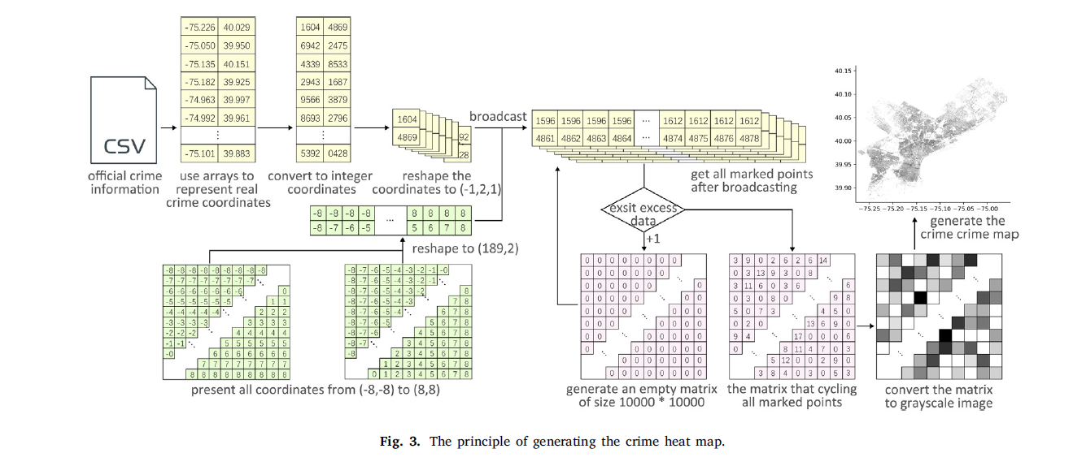
The generation of crime heat map

Slide 18
The collection of city maps
Need to collect maps from Mapbox (building information is incomplete) and Google Map (cannot distinguish specific buildings)
Have some specifications to export JSON code
all roads => black
grass => green
water => blue
background => white
The purpose of the processing of the map in this research is to improve the neural network’s ability to distinguish the positions of different spaces, and to enhance the accuracy and legibility of the results that the model generates.

Slide 19
The collection of city maps
Taking screenshots – Mouserecorder
After screenshot, 1500 mini maps are obtained
Cropping and sticking maps – NeoImaging
Generated the map manually in Photoshop with a resolution of 300dpi
The unit-longitude and unit-latitude length in the hot map are the same, while the unit-longitude and unit-latitude length in the flat map are different.
Needed zoom operation on the crime-rate heat map
After aligning the two images and removing the extra parts, everything is fine
delete outside places from the city
2,291 sets of actual maps and crime heat maps corresponding to each other are obtained. (15 sets removed for test cases – accuracy of the model)

Slide 20
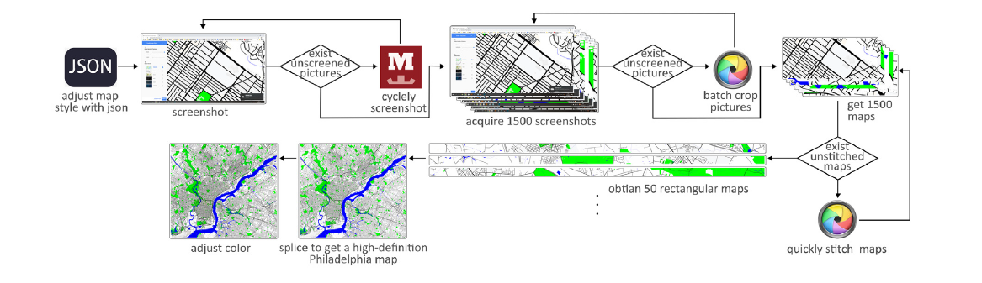
The collection of city maps

Slide 21
Neural network trainings
Main algorithm – Pix2pixHD
The continuous confrontation between the two parties is characteristic of successful and accurate GAN training.
The training process is also successful when, on repeated occasions, the generator’s loss value is low and the discriminator’s loss value is comparatively high.
In the end, the relationship between the crime heat map and the actual map was successfully ascertained through the continuous-optimization model.
After 200 epochs of training, the synthesized image performs accurately, with the crime heat map showing a clear pattern corresponding with different types of functional areas.
Therefore, we decided to stop training after 200 epochs and store the prediction model at this point as the final model.

Slide 22
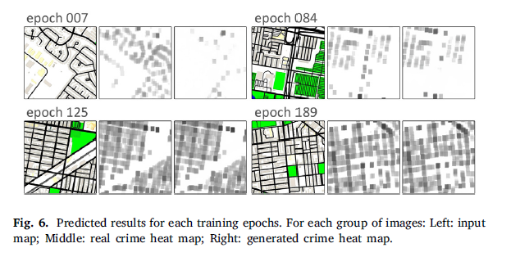
Neural network trainings

Slide 23
Results
Accuracy of the training set
Accuracy of the test set
AI-assisted urban design
Small scale city
Medium scale city
Large scale city

Slide 24
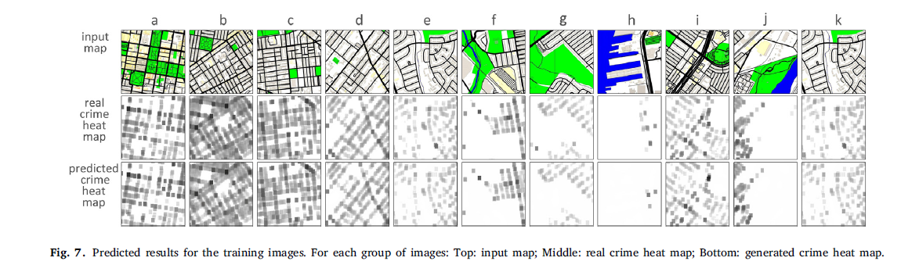
Accuracy of the training set

Slide 25
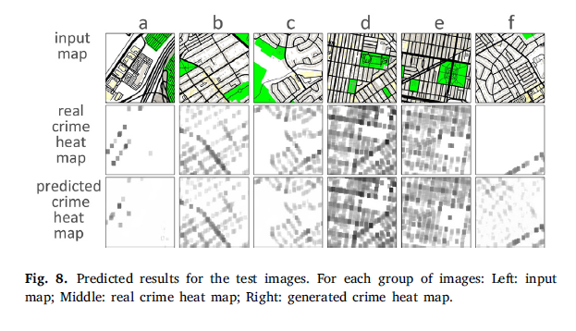
Accuracy of the test set

Slide 26
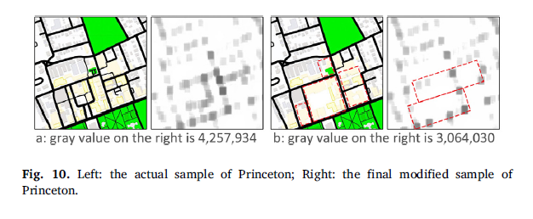
Accuracy of the training set

Slide 27
AI-assisted urban design
In order to verify the universality of the model, we generate crimerate predictions for Princeton, Seattle, and New York, representatives of small, medium, and large cities respectively, in the United States
Princeton – distributed roads and large number of dead ends
Seattle – regions with lawns and large public buildings
New York – central area of city which contains a lot of municipal buildings and townhouses
After these maps are collected and processed by the same method as described above, the model is used to predict the crime rate on these maps.

Slide 28
Princeton
Large areas of grass, municipal buildings and main roads next to grass increase possibility of crime
Some buildings removed and replaced with open spaces.
Using larger buildings shown to reduce low crime-rate points
Crime rate dropped to 72% of the original

Slide 29
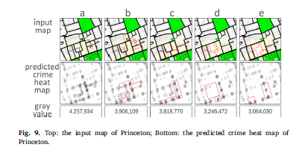
Princeton

Slide 30
Princeton

Slide 31
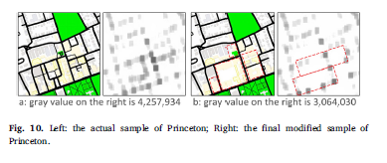
Princeton

Slide 32
Seattle
Same laws with Philadelphia
Remove more small urban lawns and streets
Downgrading streets and reducing road complexity on the long sides of green spaces

Slide 33
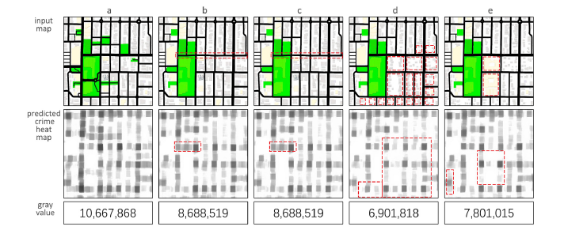
Seattle

Slide 34
Seattle

Slide 35
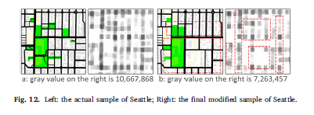
Seattle

Slide 36
New York
Deleting roads within the blocks in the sample as much as possible
Downgrading the two main roads
Replacing the large municipal buildings with small loosely distributed residential buildings

Slide 37
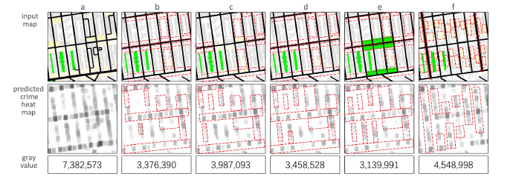
New York

Slide 38
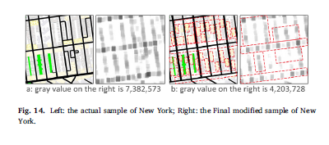
New York

Slide 39
Thank you!

